Slide 1
Tools for In-site Measurement Radio Interference Campaigns for P1451.5p
Jing Geng
Oct 17, 2022

Slide 2

Time-Sensitive Networking in Industrial Wireless Applications
Rick Candell Industrial Wireless Systems Smart Connected Systems Division
IECON 2022, Brussels

Slide 3
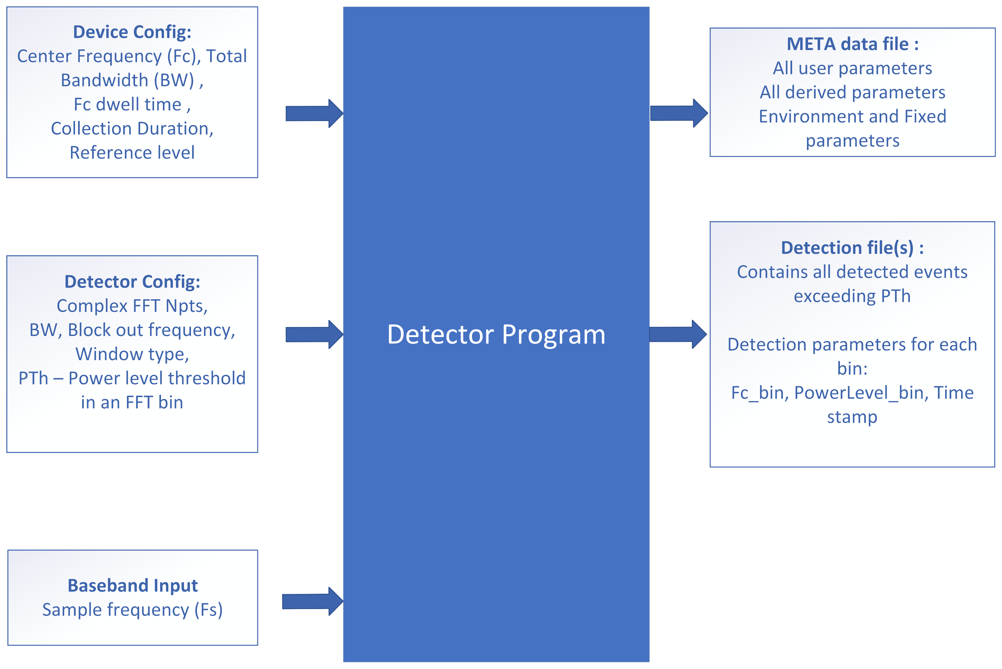
Requirements for the Spectrum Detector

Slide 4
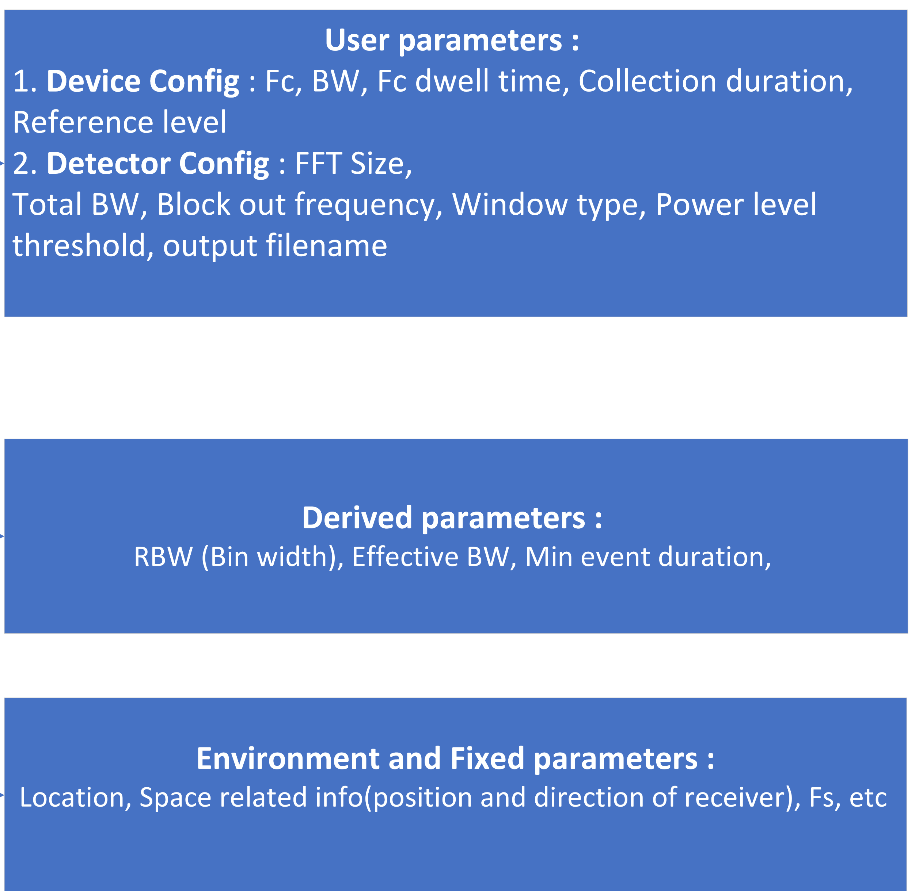
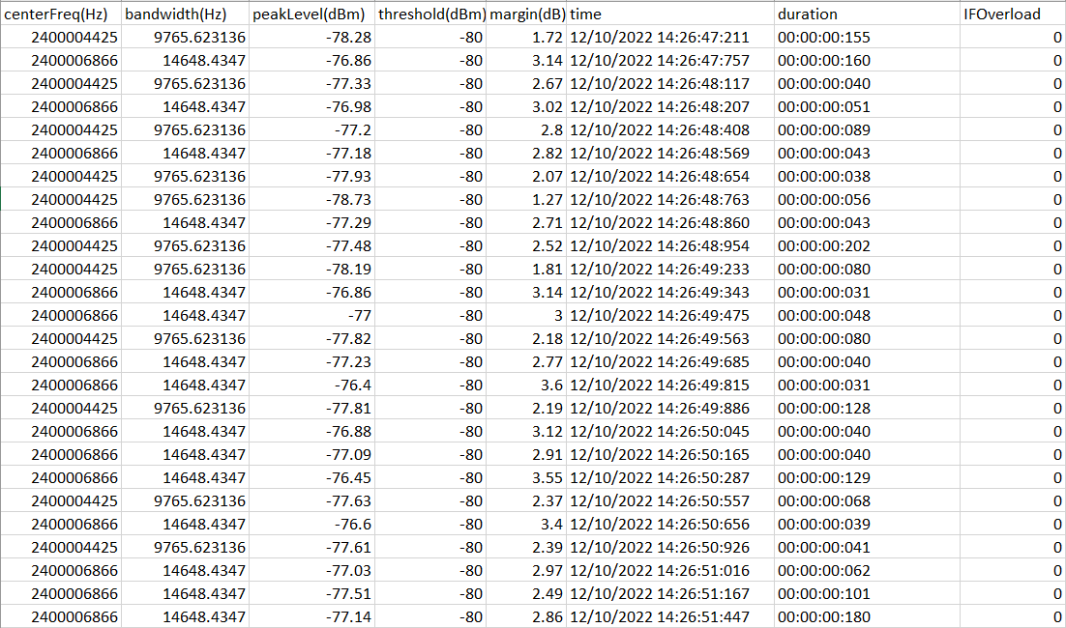
Meta Data File :
Requirements for the Spectrum Detector
Detection Event File :

Slide 5
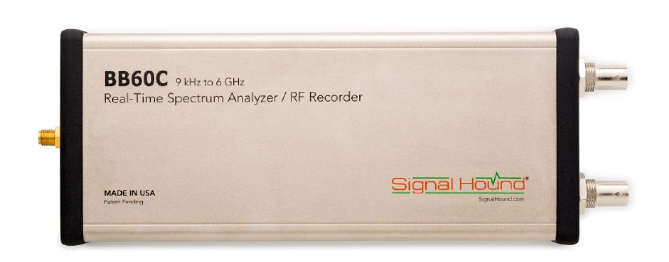
Wireless Event Capturing Approach
Basic spectrum analysis :
Sweep through certain spectrum band, max_hold/average through the capture trace
Interference hunting through spectrum device :
Device we test on : BB60C spectrum analyzer
9kHz to 6GHz
27 MHz max real-time bandwidth
Max 40M/s sample rate
Limitation :
Hardware limitation for event duration under milli-second
Notes:
Advantage : large span of bw sweep
Limiation : hardware

Slide 6
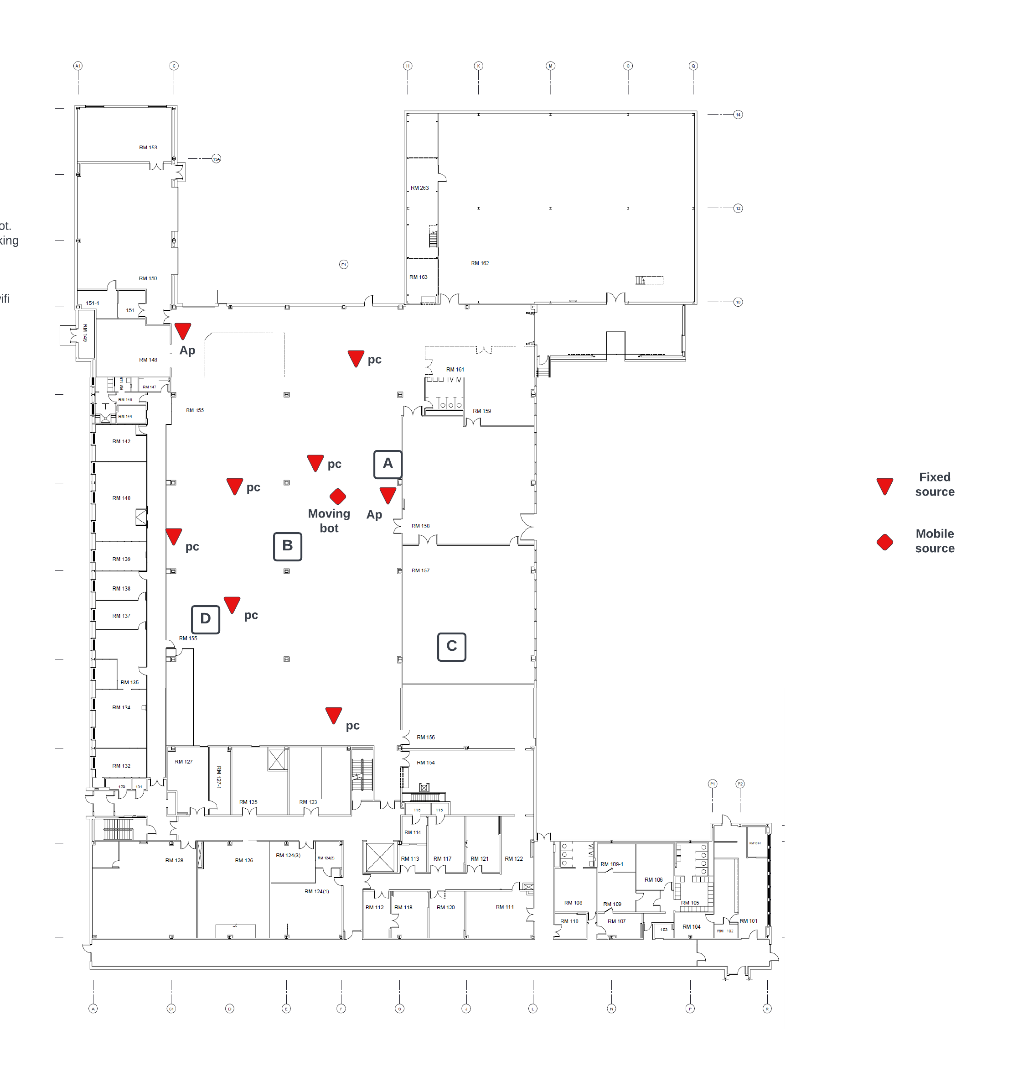
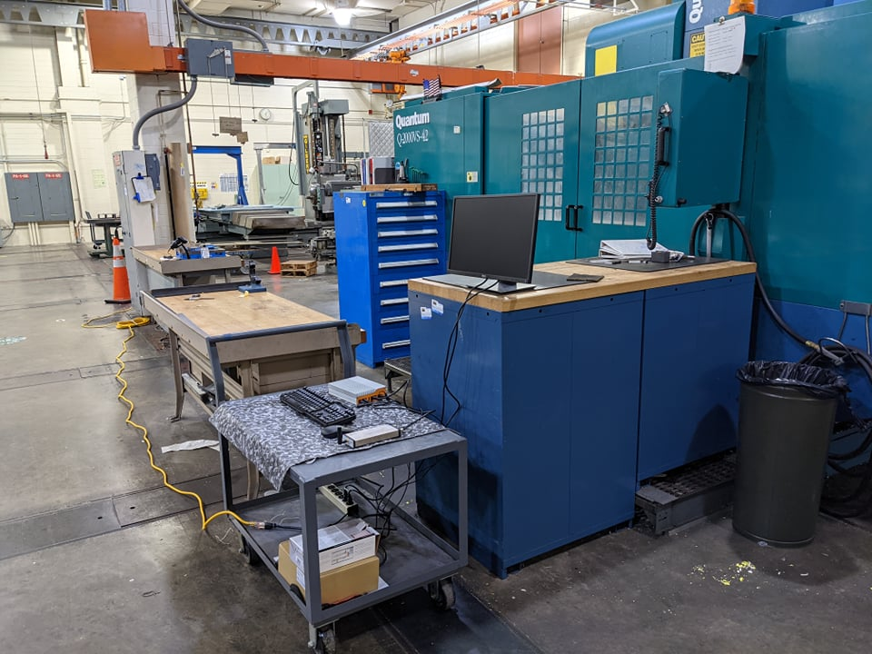
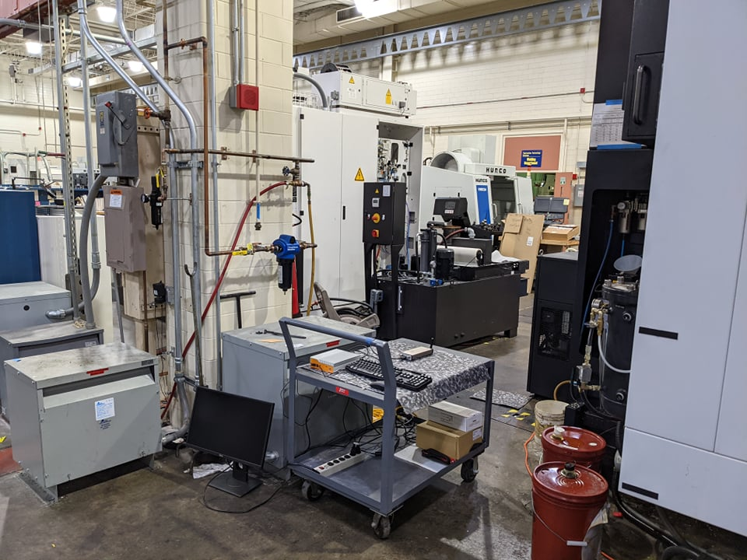
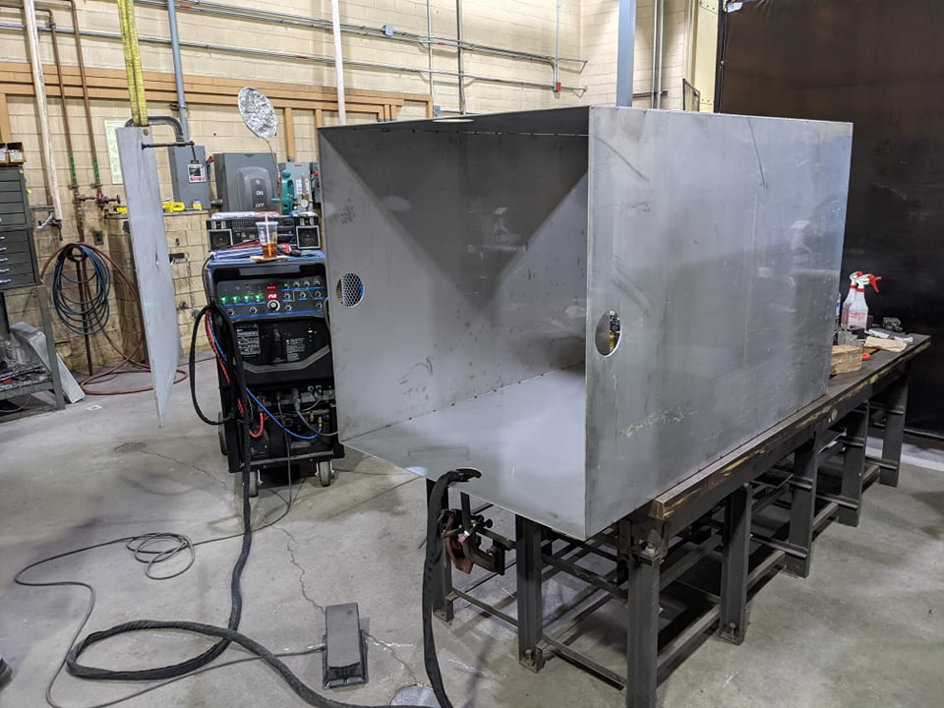
NIST Machine Shop
A space with large machines (for welding, milling, lathe work, etc), cranes and tools, workbenches, computers.
Outer dimensions of approximately 12 m x 15 m (40 ft x 50 ft) and a ceiling height of approximately 7.6 m (25 ft)
Possible sources and interference :
Wifi aps, PCs
Personal cell phones
Wireless control crane
Machine noice

Slide 7
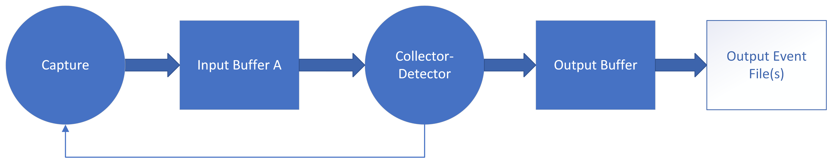
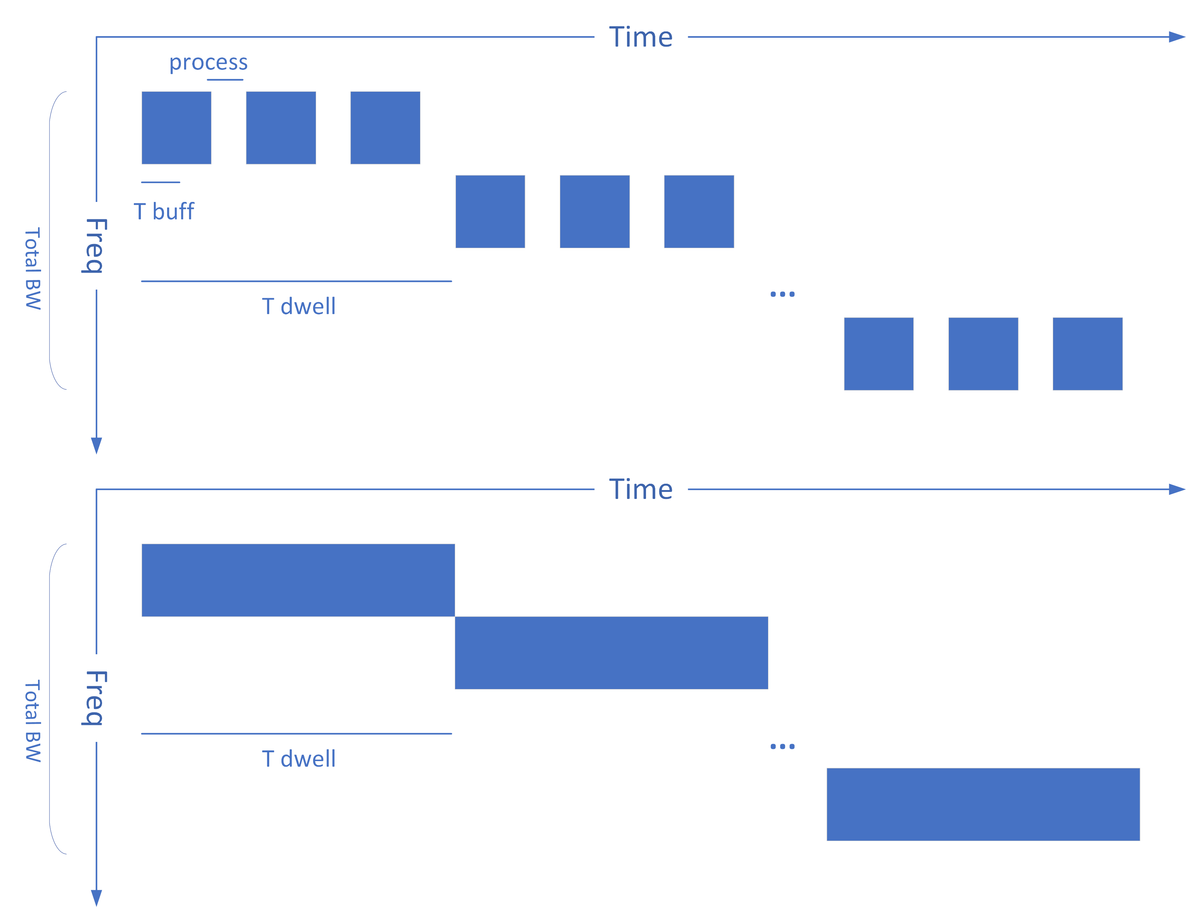
Wireless Event Capturing Approach
IQ data capturing, process, threshold, and write to events :
Sweep over Desire Bandwidth :
Limitation : real-time bandwidth, software speed

Slide 8
Wireless Event Capturing Approach
IQ data capturing, process, threshold, and write to events :
Collect data to the memory limit and do post-processing :

Slide 9
Wireless Event Capturing Approach
Zero span recording, threshold, write event :
Narrowing down a smaller bandwidth for each capturing.
Sweep and hop around the total band interested
Calculate only the IQ power for each band and do the thresholding.

Slide 10
Summary
Basic requirements for the tool for on-site measurement radio interference.
Different approaches with different limitations.
The result can help in better knowing the spectrum activities, interference patterns in different capturing environments.
Cannot replace the basic analysis for existing protocols, devices, and possibilities.
Notes:
Advantage : large span of bw sweep
Limiation : hardware

